Slide 1
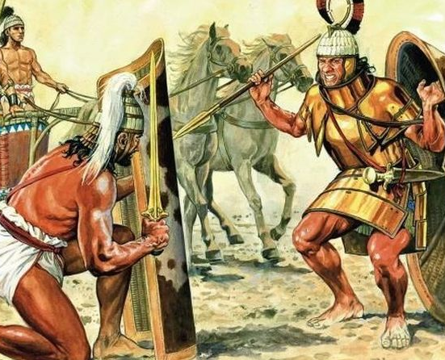
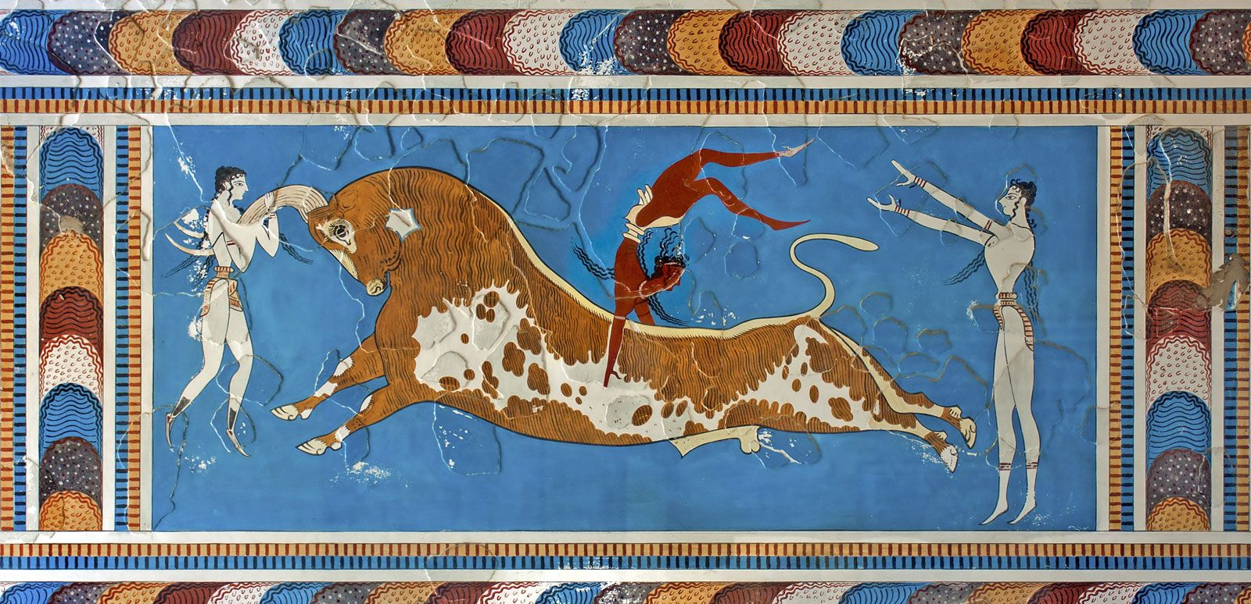
REVISION
Goal/s:
Revise key features of Minoan and Mycenean civilizations
Week 9 Lesson 1
Ms Barrie

Slide 2
Topics/Content for Test
Minoan/Mycenaeans
archaeological evidence
geography
culture
Key people: Homer, Agememnon, Heinrich Schliemann, Minotaur
similarities and differences
mythology and its impacts

Slide 3
Today’s Lesson
We will work together to create an A3 mind map of all of the CONTENT we have covered throughout this term – Minoans and Myceneans

Slide 5
REVISION
Goal/s:
Revise key features of Minoan and Mycenean civilizations
Week 9 Lesson 2
Ms Barrie

Slide 6
Two options for today’s lesson
Independent study
Create your own study resources to revise key topics with:
Flash cards
Study sheet
Revision Notes
Look/Cover/Write/Check
Test Questions
Practice Responses
Worksheet
Answer the questions on the worksheet
Complete this in your book
DO NOT use your notes to help you
Complete questions – then figure out what you need to go back and revise

